Slide 1
Information Retrieval
Course Code: BIT 406
Contact Hours: L-3 T-0 P-2
Credits: 4
Semester: 8

Slide 2
Unit 1: Vector Space Model of Retrieval
Word Statistics
Text preprocessing
Term Weighing
Similarity Function
Indexing
Relevance Feedback
Query Expansion(With Local Analysis from External Resources)
The impact of Document Normalization
Multi-Field Retrieval
Evaluation of Retrieval
Applications
Disadvantages
Incentives for Engaging in Electronic Commerce
Forces behind E-commerece

Slide 3
What exactly is Information Retrieval?
Information Retrieval
Information retrieval is defined as the process of accessing and retrieving the most appropriate information from text based on a particular query given by the user, with the help of context-based indexing or metadata.
Google Search is the most famous example of information retrieval.
Information Retrieval Systems
An information retrieval system searches a collection of natural language documents with the goal of retrieving exactly the set of documents that matches a user’s question. They have their origin in library systems.
These systems assist users in finding the information they require but it does not attempt to deduce or generate answers. It tells about the existence and location of documents that might consist of the required information that is given to the user. The documents that satisfy the user’s requirement are called relevant documents. If we have a perfect IR system, then it will retrieve only relevant documents.

Slide 4
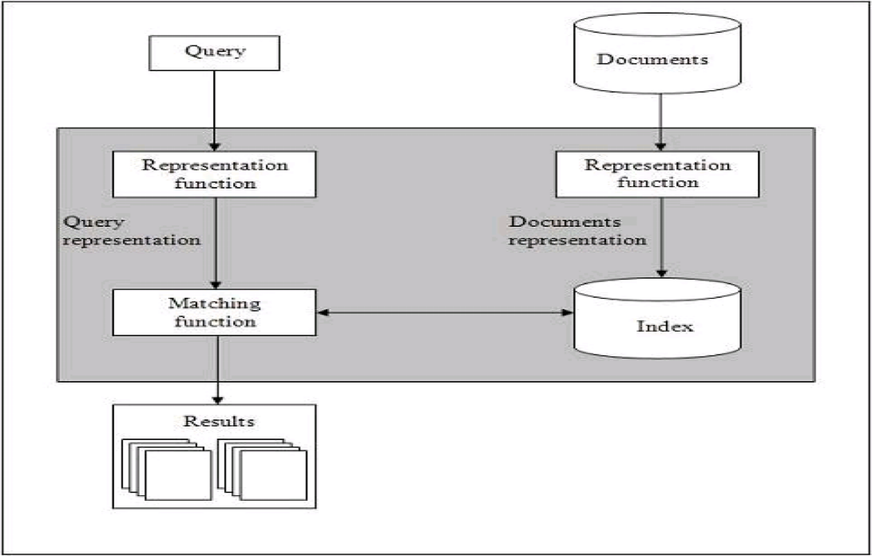
Basics of IR System
The step by step procedure of these systems are as follows:
Indexing the collection of documents.
Transforming the query in the same way as the document content is represented.
Comparing the description of each document with that of the query.
Listing the results in order of relevancy.
Retrieval Systems consist of mainly two processes:
Indexing
Matching

Slide 5
Information Retrieval
Information Retrieval (IR) is a field of study concerned with the effective and efficient retrieval of relevant information from large collections of data, typically textual documents.
It plays a crucial role in various applications, including web search engines, digital libraries, e-commerce platforms, and content recommendation systems.
The primary goal of information retrieval is to enable users to find relevant information quickly and accurately in response to their information needs or queries.

Slide 6
Information Retrieval: Key Components and Techniques
1. Document Collection: Information retrieval systems typically operate on a collection of documents, which can range from web pages and academic articles to emails and social media posts. These documents serve as the primary source of information that users seek to access.
2. Indexing: To facilitate efficient retrieval, documents are indexed based on their content, keywords, metadata, or other relevant features. Indexing structures, such as inverted indexes or forward indexes, enable fast lookup of documents containing specific terms or properties.

Slide 7
Information Retrieval: Key Components and Techniques
3. Query Processing: Users express their information needs through queries, which are typically short strings of keywords or natural language phrases. Query processing involves analyzing and understanding user queries, identifying relevant documents in the collection, and ranking them based on their relevance to the query.
4. Relevance Ranking: The relevance of a document to a given query is assessed using various ranking algorithms, such as term frequency-inverse document frequency (TF-IDF), vector space models, or machine learning-based methods. Relevance ranking aims to present the most relevant documents at the top of the search results.

Slide 8
Information Retrieval: Key Components and Techniques
5. Evaluation: The effectiveness of an information retrieval system is evaluated using metrics such as precision, recall, and F1-score. These metrics measure the system's ability to retrieve relevant documents while minimizing irrelevant ones, providing insights into its performance and guiding system optimization.
Information retrieval techniques have evolved significantly over the years, driven by advances in computer science, natural language processing, and machine learning. Modern information retrieval systems incorporate sophisticated algorithms, such as deep learning models, semantic analysis, and personalized recommendation engines, to enhance retrieval accuracy and user satisfaction.

Slide 9
Information Retrieval Models
Information retrieval models predict and explain what a user will find in relevance to the given query and consists of the following:
A model for documents.
A model for queries.
A matching function that compares queries to documents.
Mathematically, a retrieval model consists of the following components:
D: Representation for documents.
R: Representation for queries.
F: The modeling framework for D, Q along with the relationship between them.
R (q, di): A ranking or similarity function that orders the documents with respect to the query.

Slide 10
Types of IR Model
Classical IR Models: These are the simplest and easy-to-implement IR models. These are based on mathematical knowledge that was easily recognized and understood as well. Following are the examples of classical IR models:
Boolean models,
Vector models,
Probabilistic models.
Non-Classical IR Models: These are completely opposite to the classical IR models. These are based on principles other than similarity, probability, Boolean operations. Following are the examples of Non-classical IR models:
Information logic models,
Situation theory models,
Interaction models.
Alternative IR Models: It is the enhancement of the classical IR model that makes use of some specific techniques from some other fields. Following are the examples of Alternative IR models:
Cluster models,
Fuzzy models,
Latent Semantic Indexing (LSI) models.

Slide 11
Vector Space Model
This is based on Luhn’s similarity criterion, which states that “the more two representations agreed in given elements and their distribution, the higher would be the probability of their representing similar information”.
1. In this model, the index representations (documents) and the queries are represented by vectors in a T dimensional Euclidean space.
2. T represents the number of distinct terms used in the documents.
3. Each axis corresponds to one term.
4. Ranked list of documents ordered by similarity to the query where the similarity between a query and a document is computed using a metric on the respective vectors.
5. The similarity measure of a document vector to a query vector is usually the cosine of the angle between them.

Slide 12
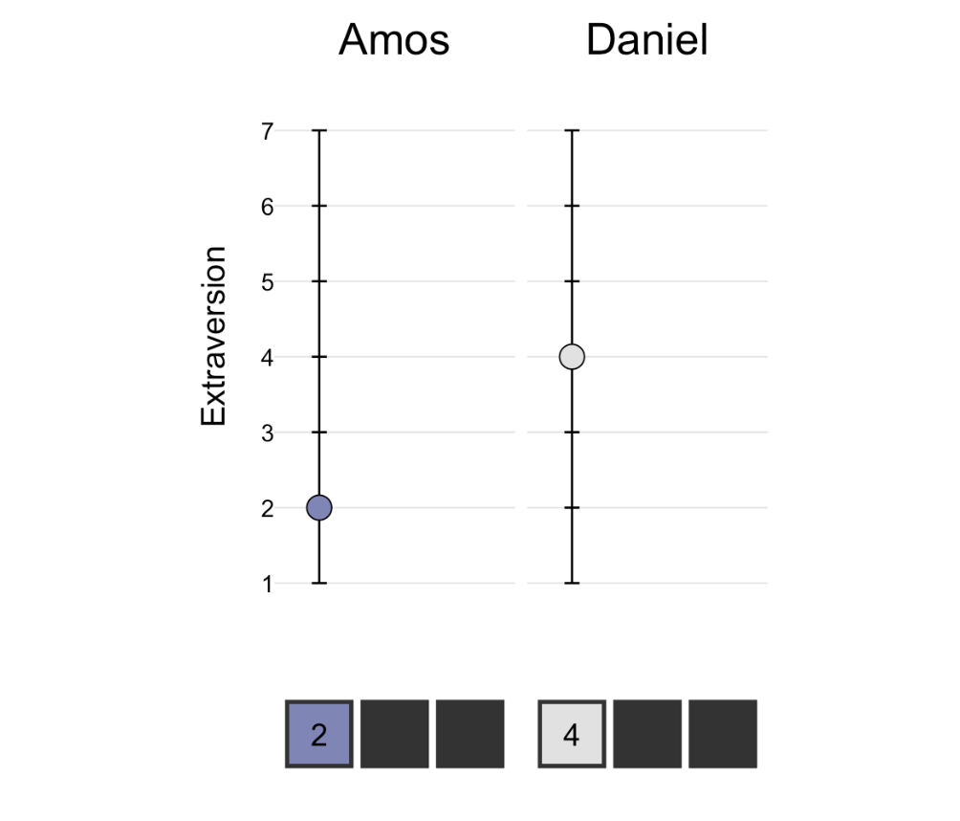
Fictional Example to understand vector Space Model
A fictional example¹: Daniel and Amos filled out a psychology questionnaire. The questionnaire measured three aspects of their personalities: extraversion, openness to experience, and neuroticism.
On the extraversion scale, Amos scored a 2 and Daniel scored a 4

Slide 13
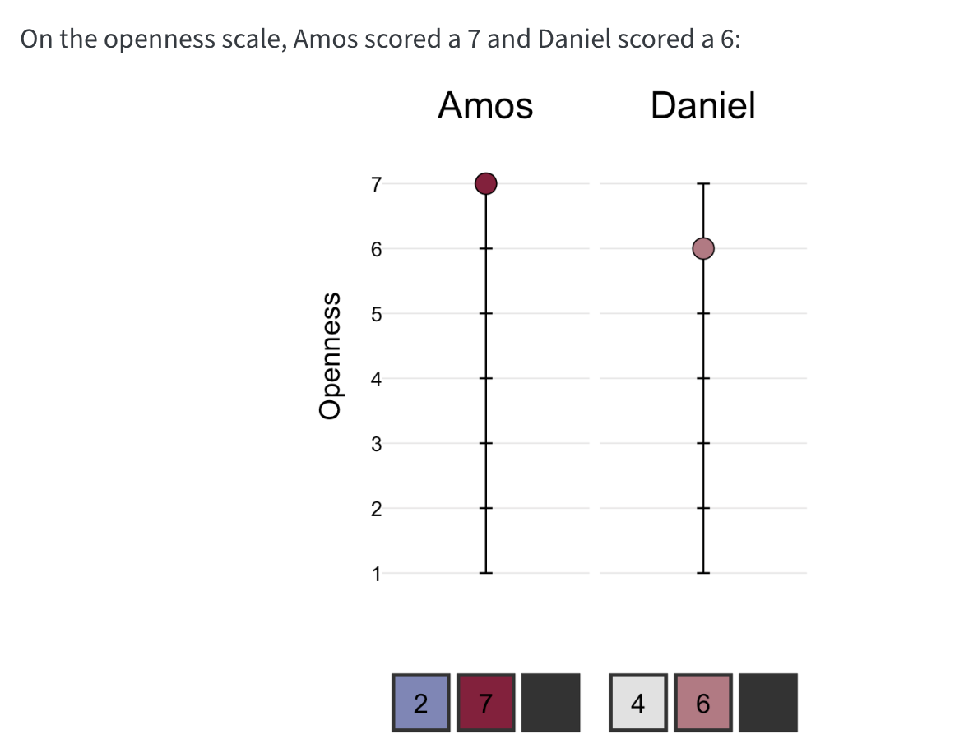
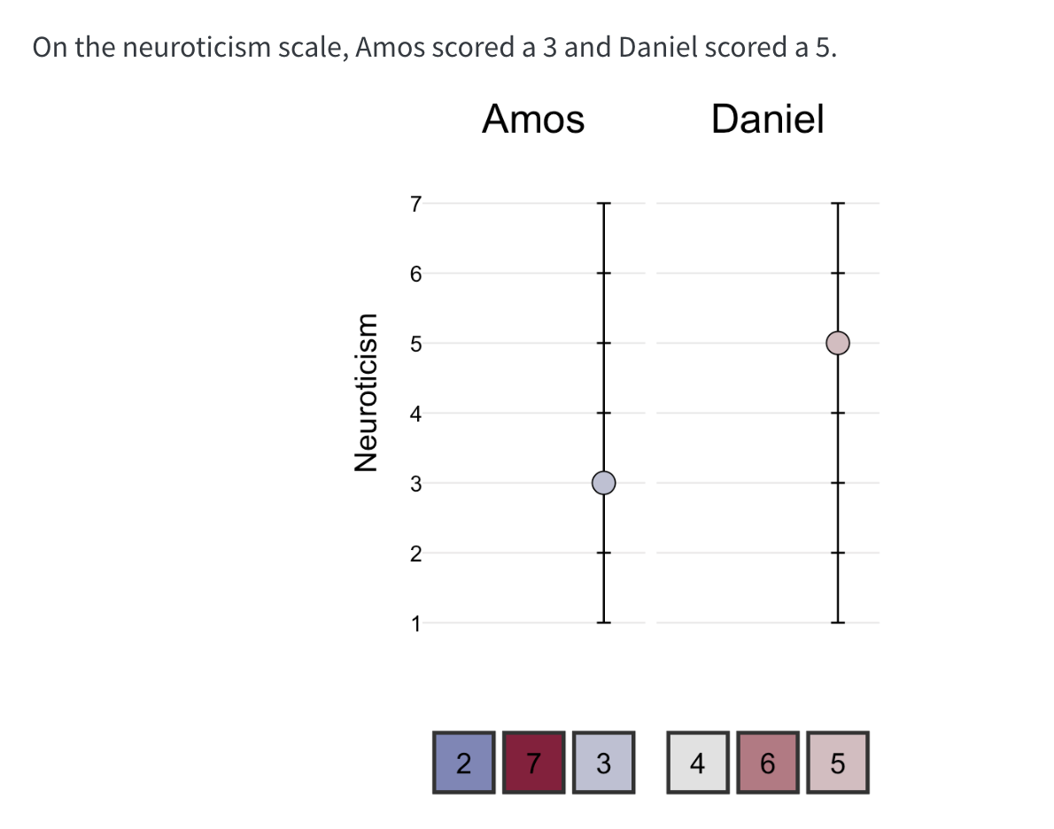
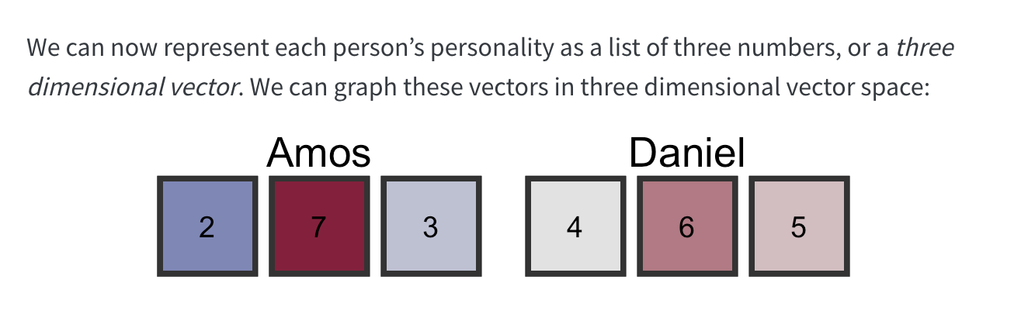

Slide 14
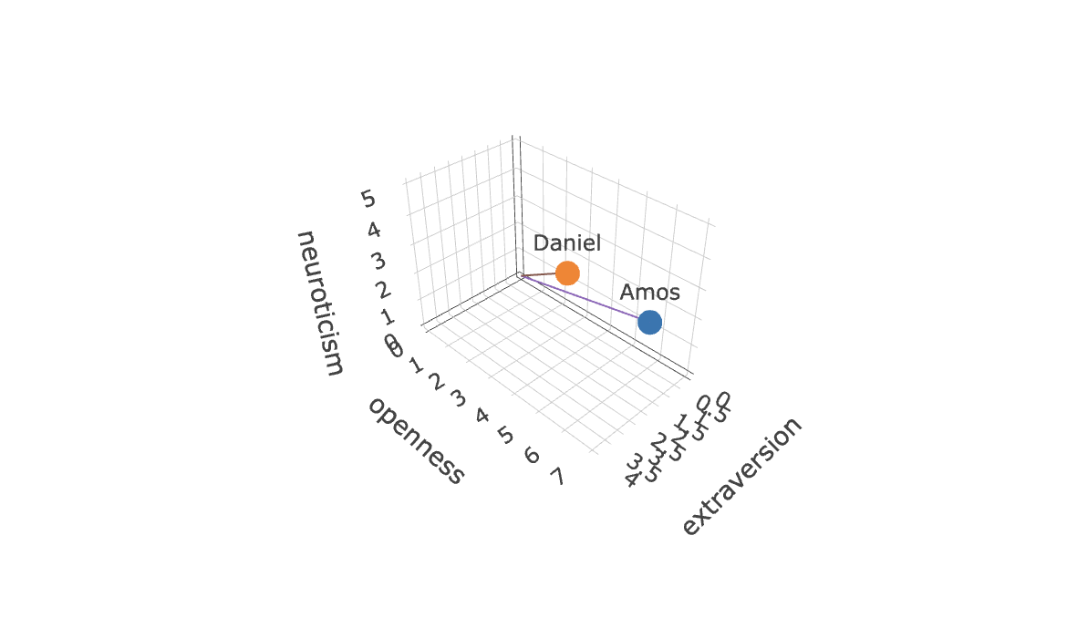
https://ds4psych.com/vectorspace-intro

Slide 15
Unit 1: Vector Space Model of Retrieval
Word Statistics
Text preprocessing
Term Weighing
Similarity Function
Indexing
Relevance Feedback
Query Expansion(With Local Analysis from External Resources)
The impact of Document Normalization
Multi-Field Retrieval
Evaluation of Retrieval
Applications
Disadvantages
Incentives for Engaging in Electronic Commerce
Forces behind E-commerece

Slide 16
Word Statistics
Word statistics refer to various quantitative measures and analyses applied to a corpus of text data to gain insights into the characteristics and patterns of the words contained within it. These statistics provide valuable information about the vocabulary, frequency distribution, and usage patterns of words in the text. Some common word statistics include:
Key statistics include:
raw counts (Bag-of-Words)
weighted frequencies (TF-IDF)
learned contextual patterns (Word Embeddings like Word2Vec), capturing meaning through co-occurrence in high-dimensional spaces.

Slide 17
Key Word Statistics & Concepts in VSM:
Term Frequency (TF): How often a word appears in a specific document, indicating its local importance.
Inverse Document Frequency (IDF): Measures a word's global rarity; common words get lower scores, rare words get higher scores, highlighting their significance across the entire collection (corpus).
TF-IDF: Combines TF and IDF to weight words, giving higher scores to terms that are frequent in a document but rare overall, creating a sparse vector.
Bag-of-Words (BoW): A simple model where each unique word in the corpus becomes a dimension, and document vectors are built from raw word counts, ignoring word order.
Word Embeddings (Word2Vec, GloVe): Modern VSMs that learn dense, low-dimensional vectors for words, capturing semantic relationships (e.g., "king" - "man" + "woman" ≈ "queen") through neural networks and context.

Slide 18
Some Common Word Statistics
Word Frequency: Word frequency counts the number of times each word occurs in the text corpus. It provides an indication of the prominence or importance of individual words within the dataset.
Word Length: Word length measures the number of characters or letters in each word. Analysing word lengths can reveal patterns such as the average word length, the distribution of word lengths, and the presence of long or short words.
Vocabulary Size: Vocabulary size refers to the total number of unique words or distinct terms present in the text corpus. It reflects the diversity and richness of the vocabulary used in the dataset.

Slide 19
Some Common Word Statistics
4. Term Frequency-Inverse Document Frequency (TF-IDF):TF-IDF is a statistical measure that evaluates the importance of a word in a document relative to a collection of documents. It combines term frequency (the frequency of a word in a document) with inverse document frequency (the frequency of the word across all documents) to identify terms that are both frequent in a document and rare across the entire corpus, thus highlighting key terms or concepts.
5. Word Distribution: Word distribution analyses how words are distributed across the corpus, including measures such as Zipf's law, which describes the frequency distribution of words in natural language texts.

Slide 20
Some Common Word Statistics
6. Stopword Frequency: Stopwords are common words such as "the," "and," "is," etc., that are often filtered out in text analysis tasks. Stopword frequency counts the occurrence of stopwords in the text and helps identify terms that may not contribute significantly to the content or meaning of the text.
7. N-grams: N-grams are sequences of N consecutive words or tokens extracted from the text. Analyzing N-gram statistics, such as bi-grams (sequences of two words) or tri-grams (sequences of three words), can provide insights into common word combinations and phrases.

Slide 21
Some Common Word Statistics
8. Word Clouds: Word clouds visually represent word statistics by displaying words with varying sizes or colors based on their frequency or importance in the text. They offer a quick and intuitive way to visualize the most common or prominent words in the dataset.
Word statistics are fundamental to various natural language processing (NLP) tasks, including text classification, sentiment analysis, information retrieval, and topic modeling. By analyzing word statistics, researchers and practitioners can uncover meaningful patterns, trends, and insights from text data, ultimately enhancing our understanding of language usage and communication.

Slide 22
Python Lab 1
https://colab.research.google.com/drive/1BGZPZe91EBJJbM9u65vFet4ti996xIRD?usp=sharing
Calculate TF,DF, TF-IDF, Bag of words from several documents(at least 3 different docs). Also note that this must be done without using Python Libraries.

Slide 23
Unit 1: Vector Space Model of Retrieval
Word Statistics
Text preprocessing
Term Weighing
Similarity Function
Indexing
Relevance Feedback
Query Expansion(With Local Analysis from External Resources)
The impact of Document Normalization
Multi-Field Retrieval
Evaluation of Retrieval
Applications
Disadvantages
Incentives for Engaging in Electronic Commerce
Forces behind E-commerece

Slide 24
Text Preprocessing
Preprocessing Task | Reasons
Noise Reduction | Text data often contains noise such as punctuation, special characters, and irrelevant symbols. Preprocessing helps remove these elements, making the text cleaner and easier to analyze.
Normalization | Different forms of words (e.g., “run,” “running,” “ran”) can convey the same meaning but appear in different forms. Preprocessing techniques like stemming and lemmatization help standardize these variations.
Tokenization | Text data needs to be broken down into smaller units, such as words or phrases, for analysis. Tokenization divides text into meaningful units, facilitating subsequent processing steps like feature extraction.
Stopword Removal | Stopwords are common words like “the,” “is,” and “and” that often occur frequently but convey little semantic meaning. Removing stopwords can improve the efficiency of text analysis by reducing noise.
Feature Extraction | Preprocessing can involve extracting features from text, such as word frequencies, n-grams, or word embeddings, which are essential for building machine learning models.
Dimensionality Reduction | Text data often has a high dimensionality due to the presence of a large vocabulary. Preprocessing techniques like term frequency-inverse document frequency (TF-IDF) or dimensionality reduction methods can help.

Slide 25
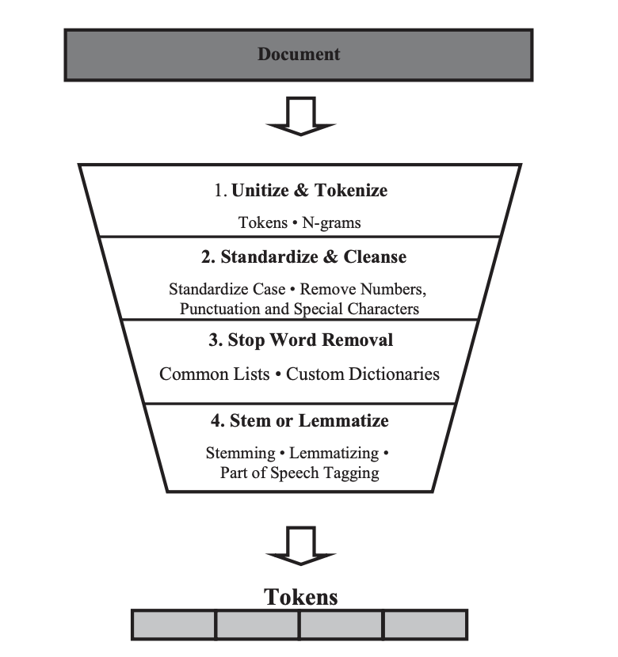
Text Preprocessing
Much of the text preparation and preprocessing methods have their roots in natural language processing.
Text preprocessing takes an input of raw text and returns cleansed tokens.
Tokens are single words or groups of words that are tallied by their frequency and serve as the features of the analysis.
The preprocessing process includes
(1) unitization and tokenization,
(2) standardization and cleansing or text data cleansing,
(3) stop word removal, and
(4) stemming or lemmatization.
This process is depicted in Figure.
Each step removes unnecessary information from the original text.
NEED of PREPROCESSING
Proper preprocessing of text data sets up the analysis for success. In text analysis, far more time is spent in preparing and preprocessing the text data than in the analysis itself (Dumais et al. 1998).
Diligent and detailed work in cleansing and preprocessing makes the analysis process smoother.
The stages along the pipeline standardize the data, thereby reducing the number of dimensions in the text dataset. There is a balance between retained information and reduced complexity in the choices made during the process.

Slide 26
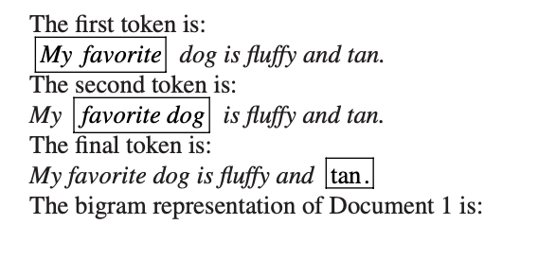
N-grams
N-grams are an alternative to single words in the tokenization process.
N-grams are tokens; they are consecutive word sequences with length n.
For instance, bigrams are tokens composed of two side-by-side words; a single word is known as a unigram.
N-grams retain information about the co-occurrence of words, because they group adjacent words into the same token.
Visualize the process as a picture frame that contains n words. Initially, the frame rests over the first n words. This counts as a token. The frame then moves over one word resulting in the exclusion of the first word. This is the second token. This process repeats for the length of the text (Struhl 2015).

Slide 27
Standardization and Cleaning
First, we want to standardize and clean the tokens. These transformations level the playing field by making the terms in each of the documents comparable. For instance, we do not want character, character, and Character to be considered separate items just because one has a comma, and another has an upper case C. This standardization and cleaning prevents this possibility from occurring.
Our first step is to convert the terms in the text to lower case. In this step, any capital letters are converted to lower case.
Following this conversion, we want to remove numbers, punctuation, and special characters. In real-world text data, there may be additional characters and tokens to clean. For instance, in some text documents, there may be extra spaces, such as white space. These are also eliminated at this stage.

Slide 28
Stop Word Removal
Next, we want to drop frequently used filler words, or stop words, which add no value to the analysis. According to the Oxford English Dictionary, and, the, be, to, and of are the most common words in the English language.
In the case of text analysis, we remove common terms because, although common terms such as these serve a grammatical purpose, they provide little information in terms of content (Salton 1989; Wilbur and Sirotkin 1992).
A collection of stop words is known as a stop list. Alternatively, this collection of words can be known as a dictionary. These lists include many different languages and methods.2 The SMART information retrieval system, introduced by Salton (1971), has a popular stop word list containing 571 words.

Slide 29
Custom Stop Word Dictionaries
Standard stop word dictionaries eliminate many of the most common words in a given language, but sometimes we also want to drop domain- or project-specific words or tokens.
In this case we can build a custom dictionary to complete this task. Often, projects will have topic-specific words that occur frequently but add little value.
To identify these words, we can also look at term frequencies. Words that have high frequencies across all documents in our collection but do not provide informational content are good candidates for removal. After making these choices, we can select a subset of the data with the term in it and read it.
While reading, we want to ensure that the term does not provide information that is relevant to the analysis question. In the creation of a custom stop word dictionary, the process should be repeated, creating subsets for reading several times to check for multiple uses of the term (Inmon 2017).
Custom dictionaries can be used in many text analysis projects and not exclusively to filter stop words. Custom dictionaries are created in information retrieval to find keywords in context (KWIC). Instead of finding tokens for removal, these keywords are used as search terms.

Slide 30
Stemming and Lemmatization
The final stage is to perform either stemming or lemmatization on the documents.
Stemming and lemmatization involve breaking words down to their root word.
Stemming involves the removal of a word’s suffix to reduce the size of the vocabulary (Porter 1980).
Lemmatization is similar to stemming, except it incorporates information about the term’s part of speech (Yatsko 2011).
Both methods combine words that contain the same root into a single token to reduce the number of unique tokens within the analysis set.
Words with a common root often share a similar meaning.
These words are then grouped into one token (Manning et al. 2008). There are exceptions to the roots of words sharing the same meaning, but the added reduction in complexity is often worth the price of incorrectly categorizing a few words.
As an example, let’s use the root train. Train has several forms, including:
– Train
– Trains
– Trained
– Training
– Trainer

Slide 31
Lemmatization
One difficulty encountered with stemming (and text analytics in general) is that a single word could have multiple meanings depending on the word’s context or part of speech.
Lemmatization deals with this problem by including the part of speech in the rules grouping word roots. This inclusion allows for separate rules for words with multiple meanings depending on the part of speech (Manning et al. 2008).
This method helps improve the algorithm by correctly grouping tokens at the cost of added complexity.

Slide 32
Python Lab 2
https://colab.research.google.com/drive/1lrSkIRz-2cpsUftgc5Ma7iLxOWx2Cdm3?usp=sharing
https://www.kaggle.com/datasets/uciml/sms-spam-collection-dataset?resource=download
Perform all the Data Preprocessing Steps on any Textual Dataset

Slide 33
Unit 1: Vector Space Model of Retrieval
Word Statistics
Text preprocessing
Term Weighting
Similarity Function
Indexing
Relevance Feedback
Query Expansion(With Local Analysis from External Resources)
The impact of Document Normalization
Multi-Field Retrieval
Evaluation of Retrieval
Applications
Disadvantages
Incentives for Engaging in Electronic Commerce
Forces behind E-commerece

Slide 34
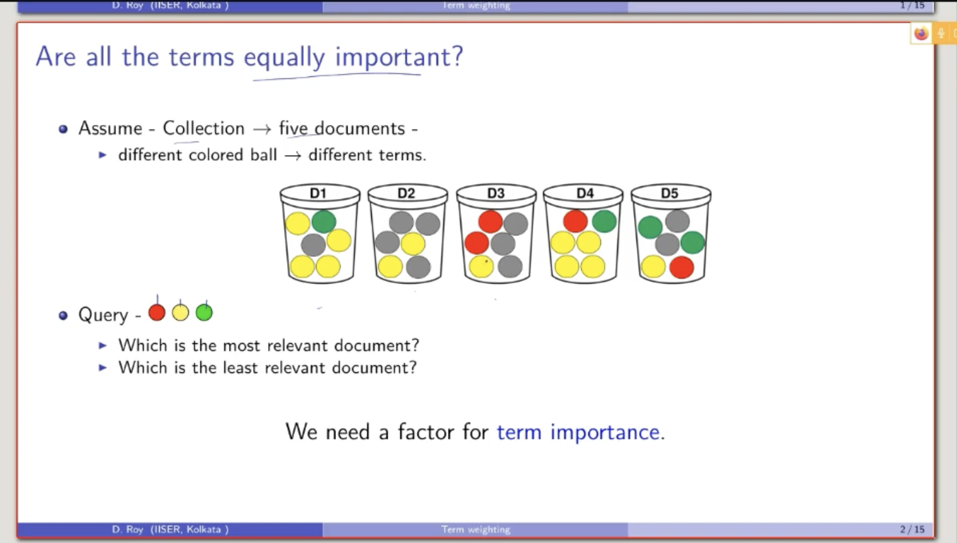
Term Weighting
Query 1: No of times a term is appearing in the document
d1:5
d2:2
d3:3
d4:6
d5:4
Query 2: Whether the query term is appearing or not
d1:2
d2:1
d3:2
d4:3
d5:3

Slide 35
Introduction to Term Weighting (Ranked Retrieval)
Information Retrieval → finding relevant documents for a user’s query
Earlier: Boolean model → document is relevant or not, no ranking
Now: Ranked retrieval → some documents are more relevant than others
Goal: assign a score to each document for a query, and rank by score
Term weighting = deciding how important each word (term) is in scoring

Slide 36
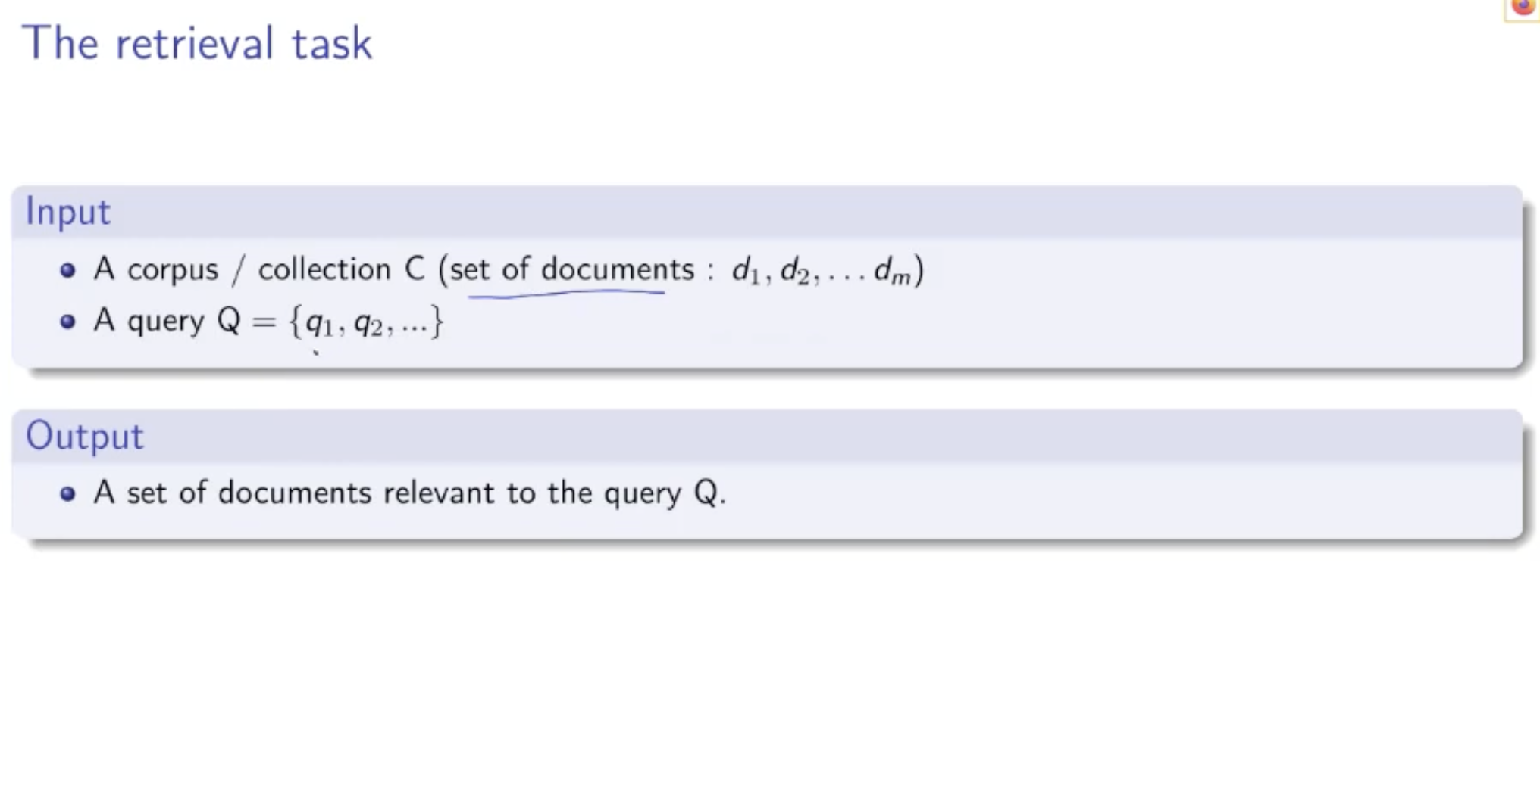
Retrieval Task and Topical Relevance
Input to retrieval model:
A collection / corpus of documents
A query (few terms: free-text / keyword query)
Output:
Documents that are topically relevant to the query
Topical relevance:
Query and document talk about the same topic
Example: query = “atom bomb” → relevant docs discuss atom bombs
In Boolean retrieval:
Exact match only → relevant / not relevant
No concept of “more relevant” vs “less relevant”
In Ranked retrieval:
Use a best-match model
Approximate relevance by similarity(query, document)

Slide 37
Bag-of-Words & Scoring Documents
A document is viewed as a bag of terms (order ignored)
“John is quicker than Mary”
“Mary is quicker than John” → Treated as the same bag of words
To score a document for a query:
Combine scores of individual terms in the document
Document score = sum or product of term scores
Important simplification:
Only query terms contribute to the score
If a query term does not appear in a document → its contribution = 0
Non-query terms in the document are ignored for scoring
So, for query Q = {q₁, q₂, q₃} and document D:
Score(D, Q) = combine weights of q₁ in D, q₂ in D, q₃ in D
These individual term weights reflect term importance

Slide 38
Term Frequency as Term Weight
Term Frequency (TF):
TF(t, d) = number of times term t occurs in document d
Used as first measure of term importance in a document
But raw TF has problems:
If TF(q, d₁) = 10 and TF(q, d₂) = 100 → d₂ is not really 10× more relevant
Could just be repetition of the same content
Relevance does not grow linearly with TF
Solution: log-frequency weighting (damping TF)
If TF(t, d) > 0:
weight(t, d) = 1 + log₁₀(TF(t, d))
If TF(t, d) = 0:
weight(t, d) = 0
Effect:
TF = 1 → weight ≈ 1
TF = 2 → ≈ 1.3
TF = 10 → 2
TF = 1000 → 4 → Big TF values no longer explode the score

Slide 39
Rare Terms, Document Frequency & IDF (Preview)
Not all terms are equally useful for retrieval:
Common words (e.g., “the”, “is”, “person”) appear in many documents
Rare words (e.g., “capricious”) are more discriminative
Document Frequency (DF):
DF(t) = number of documents in which term t appears at least once
High DF → very common term
Low DF → rare term
We want rare terms to get higher weight
Idea: Inverse Document Frequency (IDF)
IDF(t) ≈ log(N / DF(t)), where N = total number of documents
Common terms (high DF) → low IDF
Rare terms (low DF) → high IDF
Together with TF (and log TF), IDF leads to TF–IDF weighting, which is the foundation of many ranked retrieval models

Slide 40
Recap: Why Term Weighting?
Retrieval ranks documents based on relevance to a query
Early idea: Binary model
1 → term present
0 → term absent
Improved idea: Use term frequency (TF) instead of binary match
Term weights act as a signal for relevance
Goal: Assign appropriate weight so rarer & meaningful terms influence ranking more

Slide 41
From Binary Presence → Term Incidence Vector
For each term (e.g., “india”) build a vector over all documents
Document index i contains:
1 → term appears in doc i
0 → term absent in doc i
Vector length = number of documents (M)
Forms basis for Boolean Retrieval Model
But Boolean retrieval doesn’t differentiate more relevant vs less relevant

Slide 42
Term Frequency (TF) + Log Damping
Store counts instead of just presence = TF(t,d)
Problem: raw TF increases linearly, but relevance does not
Solution: Sublinear scaling using log
If TF > 0: → weight(t,d) = 1 + log₁₀(TF(t,d)) Else: → 0
Effect Example:
TF=1 → weight=1
TF=2 → 1.3
TF=10 → 2
TF=1000 → 4 → Big TF doesn’t explode score

Slide 43
Why Rare Terms Matter (Intuition)
Rare terms are more informative than common terms
Example query: “diseases caused by smoking”
Relevant info mostly in “diseases” + “smoking”
Term “cause/caused” is too generic → less useful for retrieval
Rarity depends on collection, not dictionary
Stop words removed, but many non-stopwords are still frequent

Slide 44
Unit 1: Vector Space Model of Retrieval
Word Statistics
Text preprocessing
Term Weighing
Similarity Function
Indexing
Relevance Feedback
Query Expansion(With Local Analysis from External Resources)
The impact of Document Normalization
Multi-Field Retrieval
Evaluation of Retrieval
Applications
Disadvantages
Incentives for Engaging in Electronic Commerce
Forces behind E-commerece

Slide 45
Similarity Function
A similarity function in information retrieval is a mathematical formula that calculates a numerical score indicating how closely a document matches a user query.
These functions rank documents by measuring the proximity of vector representations (like term frequency) in a vector space model, with higher scores indicating higher relevance.
Common examples include cosine, Jaccard, and Euclidean distance, typically resulting in scores between 0 and 1.
Key Aspects of Similarity Functions
Purpose: To rank documents by relevance, allowing retrieval systems to return the most relevant items first, rather than just exact matches.

Slide 46
Types of Measures:
Cosine Similarity: Measures the cosine of the angle between two vectors, focusing on the orientation rather than magnitude, which is effective for varying document lengths.
Jaccard Similarity: Calculates the ratio of shared terms (intersection) to the total unique terms (union) between two documents, ranging from 0 to 1.
Euclidean Distance: Measures the straight-line distance between two points in vector space; smaller distances indicate higher similarity.

Slide 47
Cosine Similarity
Cosine similarity is a widely used similarity measure that calculates the cosine of the angle between two vectors in a multi-dimensional space. In the context of text documents represented as term frequency vectors, cosine similarity computes the cosine of the angle between the vectors representing the documents.
Cosine similarity ranges from -1 to 1, with 1 indicating perfect similarity, 0 indicating no similarity, and -1 indicating perfect dissimilarity.

Slide 48
cosine similarity becomes wrong if the two document vectors don’t use the same word order (same feature alignment).
Vocabulary (correct shared order)
Let the vocabulary be:
["cat", "dog"]
Documents
Doc1: "cat"
Doc2: "dog"
Correct vectors (same order for both)
Using order ["cat","dog"]:
Doc1 → [1, 0]
Doc2 → [0, 1]
Cosine similarity:
dot = 1·0 + 0·1 = 0
magnitudes = 1 and 1
similarity = 0 / (1·1) = 0 (they share no words)
Wrong case (different order used for Doc2)
Suppose by mistake you build Doc2’s vector using reversed order:
["dog", "cat"]
Then:
Doc1 (still using ["cat","dog"]) → [1, 0]
Doc2 (using ["dog","cat"]) → [1, 0] ← because “dog” count comes first
Now cosine similarity:
dot = 1·1 + 0·0 = 1
magnitudes = 1 and 1
similarity = 1 / (1·1) = 1
It falsely says Doc1 and Doc2 are identical, even though they share zero common words.
Key takeaway
Cosine similarity assumes:
Index 0 in both vectors represents the same word, index 1 represents the same word, etc.
If the order differs, you’re multiplying counts of different terms together → wrong result.

Slide 49
Jaccard Similarity
In information retrieval, Jaccard similarity (or Jaccard index) is a metric used to measure the overlap between a user's query and a document. It treats both the query and the document as sets of unique terms and is calculated as the size of their intersection divided by the size of their union.
Jaccard similarity is a measure of similarity between two sets defined as the size of the intersection divided by the size of the union of the sets. In the context of text documents, Jaccard similarity is often used to compare the overlap of terms between two documents.
Jaccard similarity ranges from 0 to 1, with 1 indicating perfect similarity and 0 indicating no similarity.

Slide 50
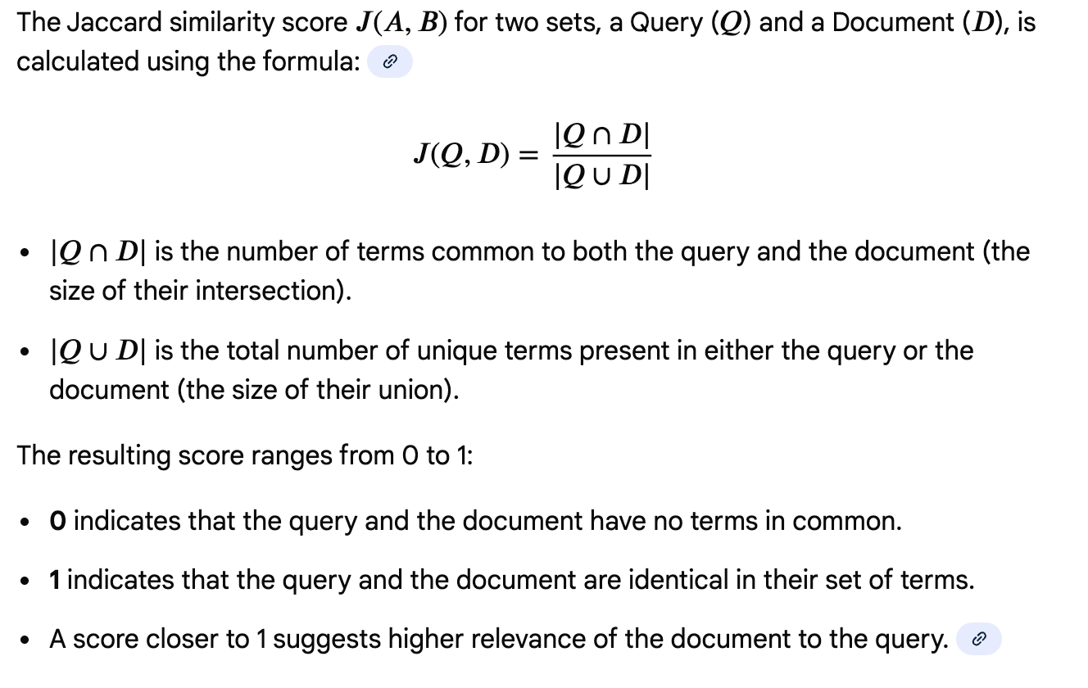
Jaccard Similarity

Slide 51
Consider a query and two documents after basic text processing (tokenization and removal of stop words like "the", "in", "of"):
Query (Q): {ides, march}; Document 1 (D1): {caesar, died, march}; Document 2 (D2): {long, march}
Calculation for Document 1:
𝑄∩𝐷1 : {march} (1 common term)
𝑄∪𝐷1 : {ides, march, caesar, died} (4 unique terms)
J(Q,D1)=1/4=0.25
Calculation for Document 2:
𝑄∩𝐷2 : {march} (1 common term)
𝑄∪𝐷2 : {ides, march, long} (3 unique terms)
J(Q,D2)=1/3≈0.33
Based on Jaccard similarity, Document 2 is considered slightly more relevant to the query than Document 1, as it has a higher Jaccard score.

Slide 52
Advantages and Limitations
Simple and intuitive: It is easy to understand and implement.
Effective for set-based similarity: Works well when only the presence or absence of terms matters.
Handles different sizes: The query and document do not need to be the same size for the calculation.
Limitations:
Ignores term frequency: It does not consider how many times a term appears, only whether it is present.
Ignores term importance/weighting: Rare, more informative terms are treated the same as common, less informative terms.
Sensitive to document length: It can yield low scores for very long documents that have a small overlap with a short query, even if the overlap is highly relevant.

Slide 53
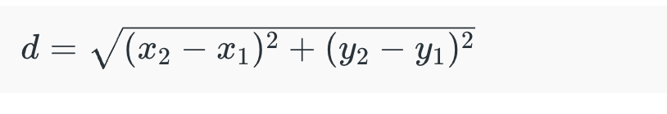
Euclidean Distance
Euclidean distance measures the straight-line distance between two points in a multi-dimensional space. In the context of text documents represented as vectors, Euclidean distance calculates the length of the straight line connecting the two vectors.
Lower values of Euclidean distance indicate higher similarity between documents.

Slide 54
Manhattan Distance
Manhattan distance, also known as city block distance or taxicab distance, measures the distance between two points by summing the absolute differences of their coordinates.
In the context of text documents, Manhattan distance calculates the sum of the absolute differences between the corresponding elements of the vectors representing the documents.
Like Euclidean distance, lower values of Manhattan distance indicate higher similarity between documents

Slide 55
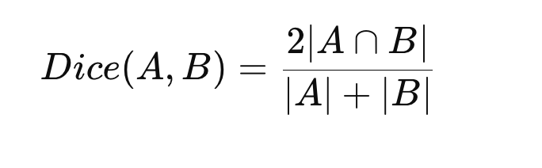
Dice Coefficient
The Dice coefficient is another similarity measure commonly used for comparing the similarity between two sets. In the context of text documents, it calculates the ratio of the size of the intersection of terms to the total number of terms in both documents.
The Dice coefficient ranges from 0 to 1, with 1 indicating perfect similarity and 0 indicating no similarity.

Slide 56
Levenshtein Distance
Levenshtein distance, also known as edit distance, measures the minimum number of single character edits (insertions, deletions, or substitutions) required to change one string into another.
In the context of text documents, Levenshtein distance can be used to compare the similarity between two text strings.
Lower values of Levenshtein distance indicate higher similarity between text strings.

Slide 57
Levenshtein Distance measures how many edits are needed to change one word into another.
Allowed Operations
Only 3 operations are allowed:
Insertion → Add a character Deletion → Remove a character Substitution → Replace a character
Simple Example
Convert: cat → cut
Operation:
a → u (substitution)
Distance = 1
Another Example
kitten → sitting
Operations:
kitten → sitten (substitute k → s)
sitten → sittin (substitute e → i)
sittin → sitting (insert g)
Distance = 3
Why It Is Useful?
Spell checking Autocomplete DNA sequence matching Search engines Plagiarism detection

Slide 58
Pearson Correlation Coefficient
Pearson correlation coefficient measures the linear correlation between two variables.
In the context of text documents represented as vectors, Pearson correlation coefficient calculates the correlation between the elements of the vectors.
Pearson correlation coefficient ranges from -1 to 1, with 1 indicating perfect positive correlation, -1 indicating perfect negative correlation, and 0 indicating no correlation.
Pearson coefficient measures how strongly two document word-frequency patterns are related.

Slide 59
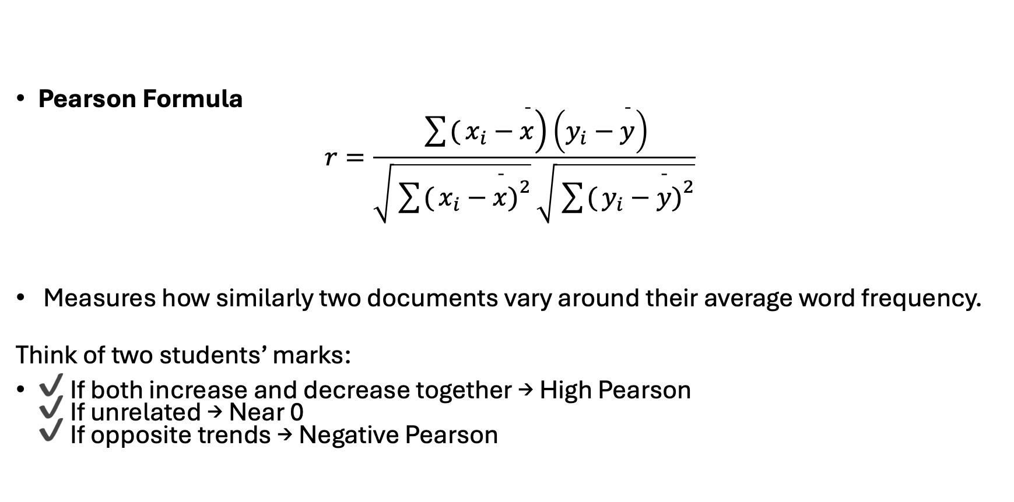
Pearson Correlation Coefficient
Pearson Formula
$$r=\frac{\sum{(}\left.x_{i}−\overset{ˉ}{x}\right)\left(y_{i}−\overset{ˉ}{y}\right)}{\sqrt{\sum{(}\left.x_{i}−\overset{ˉ}{x}{\left.)\right.}^{2}\right.}\sqrt{\sum{(}\left.y_{i}−\overset{ˉ}{y}{\left.)\right.}^{2}\right.}}$$
Measures how similarly two documents vary around their average word frequency.
Think of two students’ marks:
✔ If both increase and decrease together → High Pearson ✔ If unrelated → Near 0 ✔ If opposite trends → Negative Pearson

Slide 60
Comparison of All Measures
Measure | Type | What It Measures | Value Range | Pros | Cons | Best Applications | Example
Cosine Similarity | Similarity | Angle between document vectors | 0 to 1 | Works well with high-dimensional text data Ignores document length Very popular in NLP | Ignores word order Needs vector representation | Search engines, document clustering, recommendation systems | Google search ranking, document similarity detection
Jaccard Similarity | Similarity | Overlap of unique words | 0 to 1 | Simple Works well for set comparison Good for short text | Ignores word frequency Less sensitive to repeated terms | Plagiarism detection, duplicate detection, web crawling | Comparing hashtags in social media posts
Dice Coefficient | Similarity | Overlap with extra weight to common elements | 0 to 1 | Sensitive to common elements Useful in pattern matching | Similar limitations as Jaccard Slightly biased toward overlap | Medical image segmentation, text similarity | Comparing DNA or medical scan regions
Euclidean Distance | Distance | Straight-line distance between vectors | 0 to ∞ | Easy to understand Works well with numerical features | Sensitive to document length Poor for high-dimensional sparse data | Image processing, clustering, recommendation systems | Face recognition, K-Means clustering
Manhattan Distance | Distance | Sum of absolute differences | 0 to ∞ | Works better when features are independent Less sensitive to outliers than Euclidean | Still affected by scale Less intuitive geometrically | Grid-based navigation, clustering, city-block distance problems | Robot path planning, location-based services
Levenshtein Distance | Distance | Minimum edits between strings | 0 to ∞ | Captures spelling errors Works at character level Good for fuzzy matching | Slow for long text Not suited for document-level similarity | Spell checking, DNA matching, search autocomplete | "recieve" → "receive" correction
Pearson Coefficient | Similarity | Linear relationship between vectors | -1 to 1 | Removes bias due to scale Detects correlation trends | Sensitive to noise Requires numerical vectors | Recommendation systems, rating prediction | Movie recommendation based on user ratings

Slide 61
Python Lab 3
https://colab.research.google.com/drive/1pejrV6Vf4M_Nu8UDvNSxZI3tsANTK5-9#scrollTo=GeSTf-fX4NGJ
Perform all the similarity Measures on 2 Chosen Documents

Slide 62
Unit 1: Vector Space Model of Retrieval
Word Statistics
Text preprocessing
Term Weighing
Similarity Function
Indexing
Relevance Feedback
Query Expansion(With Local Analysis from External Resources)
The impact of Document Normalization
Multi-Field Retrieval
Evaluation of Retrieval
Applications
Disadvantages
Incentives for Engaging in Electronic Commerce
Forces behind E-commerece

Slide 63
Positional Index
A positional index is a type of inverted index used in information retrieval systems that not only records which documents contain a given term but also stores the positions (or offsets) of occurrences of that term within each document. This additional positional information allows for more advanced retrieval techniques, such as phrase search, proximity search, and phrase highlighting.

Slide 64
Basic Inverted Index
In a basic inverted index, for each term encountered in the document collection, the index maintains a posting list, which is a list of document identifiers (or pointers to documents) where the term occurs. For example:
Term: Document IDs
---------------------
cat: [1, 3, 5]
dog: [2, 4, 5, 6]

Slide 65
Positional Index Extension
In a positional index, each entry in the posting list not only contains the document ID but also includes the positions of occurrences of the term within the document. For example:
Term: (Document ID, Positions)
------------------------------
cat: [(1, [3]), (3, [2, 5]), (5, [7])]
dog: [(2, [2]), (4, [1, 4]), (5, [3, 6]), (6, [2])]
Here, Here, the numbers within the square brackets represent the positions of occurrences of the term within the corresponding document.

Slide 66
Advantages of Positional Index
Phrase Search: With positional information, it becomes possible to perform phrase searches, where the query consists of multiple terms that must appear in a specific sequence within the document.
Proximity Search: Positional information enables proximity searches, where the query specifies a maximum allowable distance between the occurrences of multiple terms.
Phrase Highlighting: Positional information can be used to highlight matched phrases within retrieved documents, improving the user experience in search applications.

Slide 67
Applications of Positional Index
Positional indexes are commonly used in search engines, where they enable more precise and context-aware searches.
They are also used in text mining and natural language processing tasks, such as named entity recognition, entity linking, and sentiment analysis, where the relative positions of terms within documents are important.

Slide 68
Challenges and Considerations
Increased Storage Requirements: Storing positional information increases the storage requirements of the index compared to a basic inverted index.
Query Processing Complexity: Retrieving documents based on positional information may involve additional computational overhead during query processing.
Index Maintenance: Updating a positional index when documents are added, deleted, or modified requires careful handling of positional information to ensure index consistency.
In summary, a positional index is a variant of the inverted index that includes positional information, enabling more advanced search capabilities such as phrase search and proximity search. Despite the additional storage and computational overhead, positional indexes are valuable for applications that require precise and context-aware information retrieval

Slide 69
Index Construction
Index construction is a critical phase in the development of an information retrieval (IR) system.
It involves the creation of data structures that enable efficient and effective retrieval of relevant documents in response to user queries. Index construction typically consists of several key steps:
1. Document Preprocessing:
2. Term Extraction:
3. Indexing:
4. Index Compression
5. Index Optimization
6. Index Storage

Slide 70
Merge based Index Model
The merge-based index model is a method used in information retrieval (IR) systems for constructing inverted indexes from a large collection of documents efficiently.
In this model, the process involves merging smaller index segments or postings lists to create a larger inverted index.
This approach is particularly useful when dealing with large-scale document collections where indexing the entire corpus in memory may not be feasible due to resource constraints.

Slide 71
Overview of the merge-based index model
1. Document Processing
2. Partitioning
3. Local Indexing
4. Merge Operation
5. Merge Strategies: Several merge strategies can be employed to efficiently merge index segments:
Two-Way Merge: In the two-way merge strategy, pairs of index segments are merged iteratively until a single merged index is obtained.
Multi-Way Merge: The multi-way merge strategy merges multiple index segments simultaneously, often using priority queues or external sorting techniques to manage memory usage and optimize performance.
Incremental Merge: In the incremental merge strategy, index segments are merged incrementally as new documents are added to the collection or existing documents are updated. This approach enables continuous index maintenance without reindexing the entire collection.
6. Index Compression:
7. Index Storage

Slide 72
Python Lab 4
https://colab.research.google.com/drive/1zUl8octlhHdmRokzEAipnCF48pLDXnPZ?usp=sharing
Create Simple Index, Positional Index and Merge Based Index for any document.

Slide 73
Unit 1: Vector Space Model of Retrieval
Word Statistics
Text preprocessing
Term Weighing
Similarity Function
Indexing
Relevance Feedback
Query Expansion(With Local Analysis from External Resources)
The impact of Document Normalization
Multi-Field Retrieval
Evaluation of Retrieval
Applications
Disadvantages
Incentives for Engaging in Electronic Commerce
Forces behind E-commerece

Slide 74
Relevance Feedback
Relevance feedback query expansion is a technique used in information retrieval to improve the relevance of search results by incorporating feedback from the user about the retrieved documents.
It aims to refine the original query by adding additional terms that are likely to capture the user’s information need more accurately, based on the relevance judgments provided by the user.

Slide 75
How relevance feedback query expansion works:
Initial Query Processing
Relevance Feedback
Query Expansion: Various techniques can be used for query expansion, including:
1. Rocchio Algorithm: The Rocchio algorithm adjusts the original query vector based on the centroids of the relevant and non-relevant document vectors in the vector space model.
2. Term Weighting: Terms from relevant documents may be assigned higher weights in the expanded query to emphasize their importance.
3. Synonym and Thesaurus Lookup: Synonyms, related terms, or concepts may be added to the query based on a thesaurus or semantic database.
4. Word Embeddings: Word embeddings models, such as Word2Vec or GloVe, can be used to find semantically similar terms to expand the query
5. Feedback-based Expansion: Terms explicitly highlighted or annotated by the user in the relevant documents may be added to the query.
Re-Retrieval
Presentation of Results

Slide 76
Python Lab 5
https://colab.research.google.com/drive/1G_Gci9v5UGOrZ8FC44bOhN7xMxGAwnvr?usp=sharing
Relevance Feedback Analysis using Rocchio Algorithm

Slide 77
Unit 1: Vector Space Model of Retrieval
Word Statistics
Text preprocessing
Term Weighing
Similarity Function
Indexing
Relevance Feedback
Query Expansion(With Local Analysis from External Resources)
The impact of Document Normalization
Multi-Field Retrieval
Evaluation of Retrieval
Applications
Disadvantages
Incentives for Engaging in Electronic Commerce
Forces behind E-commerece

Slide 78
Query expansion (with local analysis – from external resources)
Query expansion with local analysis from external resources is a technique used in information retrieval to improve the relevance of search results by augmenting the original user query with additional terms or phrases.
Unlike traditional query expansion methods that rely solely on the terms present in the document collection, this approach leverages external resources, such as knowledge bases, ontologies, or external corpora, to enrich the query with contextually relevant terms.

Slide 79
Query expansion (with local analysis – from external resources)
1. Initial Query Processing:
The retrieval process starts with an initial user query, typically consisting of a set of keywords
or phrases that describe the user's information need.
2. Local Analysis:
The original query is analyzed locally within the document collection to identify terms that are likely to be relevant to the user's query based on their co-occurrence patterns or semantic similarity with the query terms. Techniques such as term frequency-inverse document frequency (TF-IDF), co-occurrence analysis, or latent semantic analysis (LSA) may be employed to identify important terms or concepts within the document collection.

Slide 80
3. External Resources:
External resources, such as domain-specific knowledge bases, ontologies, or external corpora, are consulted to retrieve additional terms or concepts related to the original query. These external resources provide contextual information and semantic relationships that may not be explicitly present in the document collection but are relevant to the user's information need.
4. Query Expansion:
The terms or concepts obtained from the external resources are added to the original query to expand its scope and capture a broader range of relevant documents. Techniques such as term weighting, relevance feedback, or semantic similarity measures maybe used to determine the importance or relevance of the expanded terms relative to the original query.

Slide 81
5. Re-Retrieval:
The expanded query is used to perform another round of retrieval from the document collection, incorporating both the original query terms and the expanded terms. The retrieval system ranks the retrieved documents based on their relevance to the expanded query, taking into account the enriched representation of the user's information need.
6. Presentation of Results:
The final ranked list of documents, incorporating the expanded query terms, is presented to the user as the search results. The user can then review the documents and find the information they are looking for, with potentially improved relevance due to the incorporation of additional terms from external resources.

Slide 82
Query expansion (with local analysis – from external resources)
By leveraging external resources to enrich the original user query, query expansion with local analysis from external resources can help bridge the gap between the user's information need and the documents available in the collection, leading to more accurate and satisfying search results.

Slide 83
Unit 1: Vector Space Model of Retrieval
Word Statistics
Text preprocessing
Term Weighing
Similarity Function
Indexing
Relevance Feedback
Query Expansion(With Local Analysis from External Resources)
The impact of Document Normalization
Multi-Field Retrieval
Evaluation of Retrieval
Applications
Disadvantages
Incentives for Engaging in Electronic Commerce
Forces behind E-commerece

Slide 84
The impact of document normalization
Document normalization refers to the process of standardizing or transforming documents in a text corpus to a common representation, often to improve the performance of information retrieval (IR)systems.
The impact of document normalization on IR systems can be significant and can influence various aspects of retrieval effectiveness.

Slide 85
The impact of document normalization
Improved Retrieval Accuracy: Document normalization can help improve the accuracy of retrieval by reducing the variability in document representations. By standardizing aspects such as capitalization, punctuation, and word forms (e.g., converting words to their base forms through stemming or lemmatization), normalization ensures that similar documents are more likely to be retrieved for a given query. For example, without normalization, "car" and "cars" might be treated as different terms, leading to potentially relevant documents being missed. Normalization ensures that variations of terms are mapped to a common representation, increasing the likelihood of retrieving relevant documents.

Slide 86
The impact of document normalization
Reduced Lexical Ambiguity: Document normalization techniques such as stemming and lemmatization can help reduce lexical ambiguity by transforming words to their base forms. This reduces the number of distinct terms in the vocabulary and helps capture the semantic similarity between related terms.
By reducing lexical variation, normalization can lead to more accurate retrieval results, especially in cases where documents contain synonyms, misspellings, or morphological variations of terms.

Slide 87
The impact of document normalization
Minimized Effects of Stop Words: Stop words, such as "and," "the," and "of," are common words that occur frequently in documents but typically carry little semantic meaning. Normalization often involves removing stop words from documents to reduce noise in the index and improve retrieval efficiency.
By eliminating stop words, normalization can focus retrieval efforts on content-bearing terms that are more indicative of document relevance, thereby improving the precision of retrieval results.

Slide 88
The impact of document normalization
Enhanced Computational Efficiency : Normalization can contribute to improved computational efficiency in IR systems by reducing the size of the index and decreasing the processing time required for query evaluation.
By standardizing document representations and reducing the number of distinct terms, normalization can lead to smaller index sizes and faster retrieval times, especially in large-scale document collections.

Slide 89
The impact of document normalization
Impact on Recall and Precision : Document normalization can have varying effects on recall (the proportion of relevant documents retrieved) and precision (the proportion of retrieved documents that are relevant).
While normalization techniques such as stemming and lemmatization can improve recall by capturing variations of terms, they may also introduce noise or ambiguity that could affect precision. The choice of normalization technique should be carefully evaluated to strike a balance between recall and precision.

Slide 90
The impact of document normalization
In summary, document normalization plays a crucial role in information retrieval by standardizing document representations, reducing lexical ambiguity, minimizing the effects of stop words, enhancing computational efficiency and ultimately improving the accuracy of retrieval results.
However, the impact of normalization on retrieval effectiveness may vary depending on factors such as the characteristics of the document collection, the choice of normalization techniques, and the specific retrieval tasks at hand.

Slide 91
Unit 1: Vector Space Model of Retrieval
Word Statistics
Text preprocessing
Term Weighing
Similarity Function
Indexing
Relevance Feedback
Query Expansion(With Local Analysis from External Resources)
The impact of Document Normalization
Multi-Field Retrieval
Evaluation of Retrieval
Applications
Disadvantages
Incentives for Engaging in Electronic Commerce
Forces behind E-commerece

Slide 92
Multi-Field Retrieval
The term "multi-field retrieval model" typically refers to an information retrieval model that considers multiple fields or attributes of documents when performing retrieval. These fields could include different aspects of the documents, such as title, body, author, date, category, etc.
Multifield retrieval models aim to improve the relevance of retrieved documents by incorporating information from multiple fields and weighting them appropriately during the retrieval process.

Slide 93
Overview of the multi-field retrieval model
1. Document Representation: In a multi-field retrieval model, each document is represented as a combination of fields, where each field corresponds to a specific attribute or aspect of the document.
* For example, a document may have fields such as title, body, author, date, and category. Each field contains textual or structured information related to that aspect of the document.
2. Field Weighting: In multi-field retrieval, different fields may contribute differently to the overall relevance of a document to a query.
For example, the title field may be considered more important than the body field for certain types of queries. Field weighting techniques assign weights to each field based on its importance or relevance to the query. These weights can be determined empirically or based on domain knowledge.

Slide 94
Overview of the multi-field retrieval model
3. Query Processing: When a user submits a query to the retrieval system, the query may contain terms or keywords that are associated with specific fields.
*For example, a user may specify that they are interested in documents with certain terms appearing in the title field, while other terms may be more flexible in their field assignment. The retrieval system processes the query and retrieves documents that match the query terms across the specified fields.
4. Field-Specific Ranking : After retrieving documents that match the query terms, the multi-field retrieval model ranks these documents based on their relevance to the query, considering the weights assigned to each field. Documents that contain query terms in more important fields or fields with higher weights are given higher rankings in the search results.

Slide 95
Overview of the multi-field retrieval model
5. Integration of Field Scores: The relevance scores obtained from individual fields are typically integrated to produce a final ranking score for each document. This integration process can be performed using various methods, such as linear combination, weighted sum, or machine learning algorithms.
6. Presentation of Results : The final ranked list of documents, incorporating scores from multiple fields, is presented to the user as the search results. The user can then review the documents and find the information they are looking for, with potentially improved relevance due to the consideration of multiple fields

Slide 96
Overview of the multi-field retrieval model
Overall, the multi-field retrieval model offers a flexible and effective approach to information retrieval by considering multiple aspects of documents and incorporating them into the retrieval process. By weighting fields appropriately and integrating field-specific scores, multi-field retrieval models can improve the relevance and quality of retrieved documents, leading to a better user experience in search applications.

Slide 97
Unit 1: Vector Space Model of Retrieval
Word Statistics
Text preprocessing
Term Weighing
Similarity Function
Indexing
Relevance Feedback
Query Expansion(With Local Analysis from External Resources)
The impact of Document Normalization
Multi-Field Retrieval
Evaluation of Retrieval
Applications
Disadvantages
Incentives for Engaging in Electronic Commerce
Forces behind E-commerece

Slide 98
Evaluation of IR Systems
Evaluation of Information Retrieval (IR) systems is crucial for assessing their effectiveness, performance, and user satisfaction. Various evaluation metrics and methodologies are employed to measure the quality of retrieval results and to compare different retrieval algorithms and systems.

Slide 99
key aspects of the evaluation of IR systems
1. Relevance Judgment: Relevance judgment is the process of determining whether a document retrieved by the system is relevant to the user's information need. It involves human assessors or judges who evaluate the retrieved documents based on predefined criteria. Relevance judgments can be binary (relevant or non-relevant), graded (on a scale), or multidimensional (covering different aspects of relevance).

Slide 100
key aspects of the evaluation of IR systems
2. Evaluation Metrics:
Precision and Recall: Precision measures the proportion of retrieved documents that are relevant, while recall measures the proportion of relevant documents that are retrieved.
F1 Score: The F1 score is the harmonic mean of precision and recall, providing a balanced measure of retrieval performance.
Mean Average Precision (MAP): MAP calculates the average precision across multiple queries, providing an overall measure of retrieval effectiveness.
Normalized Discounted Cumulative Gain (NDCG): NDCG evaluates the ranking quality of retrieved documents, considering both relevance and ranking position.
Precision at k (P@k): Precision measured at a specific rank k in the ranked list of retrieved documents.
Mean Reciprocal Rank (MRR): MRR measures the effectiveness of retrieving the highest-ranked relevant document for each query.

Slide 101
key aspects of the evaluation of IR systems
3. Test Collections
Test collections are curated datasets used for evaluating IR systems.
They consist of a set of queries, a document collection, and relevance judgments for each query-document pair.
Common test collections include the Cranfield collection, TREC (Text Retrieval Conference) datasets, and CLEF (Conference and Labs of the Evaluation Forum) datasets

Slide 102
key aspects of the evaluation of IR systems
4. Experimental Setup
Evaluation experiments involve running the IR system on the test collection and computing the evaluation metrics based on the retrieval results and relevance judgments.
Cross-validation and randomization techniques may be used to ensure the robustness and reliability of the evaluation results.

Slide 103
key aspects of the evaluation of IR systems
4. User Studies
User studies involve soliciting feedback from actual users of the IR system to assess their satisfaction, usability, and perceived relevance of retrieved documents.
User studies may include surveys, interviews, or user interaction logging to gather qualitative and quantitative data on user behavior and preferences.

Slide 104
key aspects of the evaluation of IR systems
6. Benchmarking
Benchmarking involves comparing the performance of different IR systems or algorithms using standardized test collections and evaluation metrics.
Benchmarking helps identify the strengths and weaknesses of different approaches and facilitates progress in the field by establishing baselines and best practices

Slide 105
key aspects of the evaluation of IR systems
7. Iterative Improvement
Evaluation results are used to iteratively improve IR systems by fine-tuning algorithms, adjusting parameters, or incorporating user feedback.
Continuous evaluation and feedback help ensure that IR systems meet the evolving needs and expectations of users.

Slide 106
key aspects of the evaluation of IR systems
Overall, evaluation of IR systems is a multifaceted process that combines quantitative metrics, qualitative feedback, and real-world user experiences to assess and enhance retrieval effectiveness, efficiency, and user satisfaction.

Slide 107
Unit 1: Vector Space Model of Retrieval
Word Statistics
Text preprocessing
Term Weighing
Similarity Function
Indexing
Relevance Feedback
Query Expansion(With Local Analysis from External Resources)
The impact of Document Normalization
Multi-Field Retrieval
Evaluation of Retrieval
Applications
Disadvantages
Incentives for Engaging in Electronic Commerce
Forces behind E-commerece

Slide 108
Evaluation of retrieval. Applications. and Disadvantages
Evaluation of Retrieval:
Metrics: Various metrics are used to evaluate the performance of retrieval systems, including precision, recall, F1 score, mean average precision (MAP), normalized discounted cumulative gain (nDCG), and precision-recall curves.
Test Collections: Evaluation is often conducted on standardized test collections, which consist of a set of queries, relevant documents for each query (judged by human assessors), and a retrieval system's output for those queries.
Cross-Validation: Cross-validation techniques, such as k-fold cross-validation or leave-oneout cross-validation, may be used to assess the robustness and generalization of retrieval models.
User Studies: In addition to traditional metrics, user studies and feedback are valuable for evaluating the effectiveness of retrieval systems in meeting user needs and preferences.

Slide 109
Evaluation of retrieval. Applications. and Disadvantages
2. Applications:
Web Search Engines: Web search engines, such as Google and Bing, use retrieval systems to match user queries with relevant web pages from the vast amount of information available on the internet.
Enterprise Search: In organizations, retrieval systems are used to search and retrieve relevant documents, emails, and other resources from internal repositories, improving knowledge management and information access.
Digital Libraries: Digital libraries employ retrieval systems to enable users to search and access digital resources, such as academic papers, books, and multimedia content, stored in online repositories.
E-commerce: E-commerce platforms utilize retrieval systems to match user queries with relevant products, enhancing the shopping experience and facilitating product discovery.

Slide 110
Evaluation of retrieval. Applications. and Disadvantages
3. Disadvantages:
Ambiguity and Noise: Retrieval systems may struggle with ambiguous queries, misspellings, and noisy or irrelevant documents, leading to suboptimal results.
Scalability: Building efficient retrieval systems that can handle large-scale document collections and serve a large number of concurrent users can be challenging and resource intensive.
Bias and Fairness: Retrieval systems may exhibit bias in the selection and ranking of documents, potentially leading to unfair or discriminatory outcomes, especially in sensitive domains such as healthcare or hiring.
Cold Start Problem: New or rare queries with limited historical data may pose challenges for retrieval systems, as they may lack sufficient information to provide relevant results.
Dynamic Content: Retrieval systems must continuously adapt to changes in the document collection, user preferences, and evolving information needs, requiring ongoing maintenance and updates.

Slide 111
Evaluation of retrieval. Applications. and Disadvantages
Despite these challenges, retrieval systems play a crucial role in facilitating access to information in various domains and have become indispensable tools for users in their everyday tasks, research endeavors, and decision-making processes. Ongoing research and advancements in the field aim to address these challenges and further improve the effectiveness and usability of retrieval systems.

Slide 112
Unit 1: Vector Space Model of Retrieval
Word Statistics
Text preprocessing
Term Weighing
Similarity Function
Indexing
Relevance Feedback
Query Expansion(With Local Analysis from External Resources)
The impact of Document Normalization
Multi-Field Retrieval
Evaluation of Retrieval
Applications
Disadvantages
Incentives for Engaging in Electronic Commerce
Forces behind E-commerece

Slide 113
Incentives for engaging in electronic commerce
Engaging in electronic commerce (e-commerce) offers various incentives for businesses, consumers, and other stakeholders involved. Here are some key incentives
1. Global Reach: E-commerce provides businesses with the opportunity to reach a global audience without the constraints of geographical boundaries. This enables access to a larger market and potential customers beyond local or regional markets.
2. 24/7 Availability: Online stores are accessible 24/7, allowing customers to browse, shop, and make purchases at any time convenient for them. This flexibility in accessibility enhances customer convenience and satisfaction.

Slide 114
Incentives for engaging in electronic commerce
3. Cost Efficiency: E-commerce often involves lower operational costs compared to traditional brick-and-mortar stores. Businesses can save on expenses related to physical infrastructure, rent, utilities, and staffing. Additionally, automation of processes such as inventory management and order processing can lead to further cost savings.
4. Wider Product Range: E-commerce platforms offer businesses the ability to showcase a wider range of products and services compared to physical stores. This allows businesses to cater to diverse customer needs and preferences, leading to increased sales opportunities.

Slide 115
Incentives for engaging in electronic commerce
5. Personalization and Targeting: E-commerce platforms can leverage customer data and analytics to personalize the shopping experience for individual customers. Personalized product recommendations, targeted marketing campaigns, and customized promotions can enhance customer engagement and loyalty.
6. Convenience: E-commerce offers convenience for both businesses and consumers. Customers can shop from the comfort of their homes or on the go using mobile devices, eliminating the need for physical travel to stores. Similarly, businesses can manage operations remotely and efficiently.

Slide 116
Incentives for engaging in electronic commerce
7. Data Insights: E-commerce platforms generate vast amounts of data on customer behaviour, preferences, and purchasing patterns. Businesses can leverage this data to gain valuable insights into market trends, consumer preferences, and competitor analysis, enabling informed decision-making and strategic planning.
8. Scalability: E-commerce businesses have the potential for rapid scalability and growth. With the right infrastructure and technology in place, businesses can quickly expand their operations to new markets, add new products or services, and accommodate increasing demand

Slide 117
Incentives for engaging in electronic commerce
9. Improved Customer Service: E-commerce platforms enable businesses to provide better customer service through features such as live chat support, self-service options, and fast resolution of inquiries or issues. Enhanced customer service leads to higher customer satisfaction and loyalty.
10. Environmental Impact: E-commerce can have a lower environmental impact compared to traditional retail models. By reducing the need for physical storefronts and transportation, ecommerce can contribute to lower carbon emissions and resource consumption.
Overall, engaging in e-commerce offers numerous incentives for businesses, consumers, and society as a whole, driving innovation, economic growth, and efficiency in the digital marketplace.

Slide 118
Unit 1: Vector Space Model of Retrieval
Word Statistics
Text preprocessing
Term Weighing
Similarity Function
Indexing
Relevance Feedback
Query Expansion(With Local Analysis from External Resources)
The impact of Document Normalization
Multi-Field Retrieval
Evaluation of Retrieval
Applications
Disadvantages
Incentives for Engaging in Electronic Commerce
Forces behind E-commerece

Slide 119
Forces behind E-Commerce for using IR
Information retrieval (IR) plays a crucial role in the success of e-commerce by facilitating efficient search, retrieval, and presentation of relevant products and services to users. Several forces drive the adoption of IR in e-commerce:
1. Vast Product Catalogs: E-commerce platforms often have vast product catalogs with thousands or even millions of items. IR enables users to efficiently navigate and search through these catalogs to find products that meet their specific needs and preferences.

Slide 120
Forces behind E-Commerce for using IR
2. Personalization: Personalized recommendations and search results enhance the user experience and increase engagement. IR techniques analyze user behavior, purchase history, and preferences to deliver tailored product recommendations and search results, leading to higher conversion rates and customer satisfaction.
3. Dynamic Inventory: E-commerce inventory is dynamic, with products being added, removed, or updated frequently. IR systems help manage this dynamic inventory by indexing and updating product information in real-time, ensuring that users have access to the latest and most relevant product listings.

Slide 121
Forces behind E-Commerce for using IR

Slide 122
Forces behind E-Commerce for using IR

